Slide 1
Used Car Price Prediction
By PS³ Group

Slide 2
About :
This project is machine learning based project.
This project helps the buyer to buy a used car at the right price
Sitemap :
Index
Prediction 1
Prediction 2
Analysis 1
Analysis 2
About

Slide 3
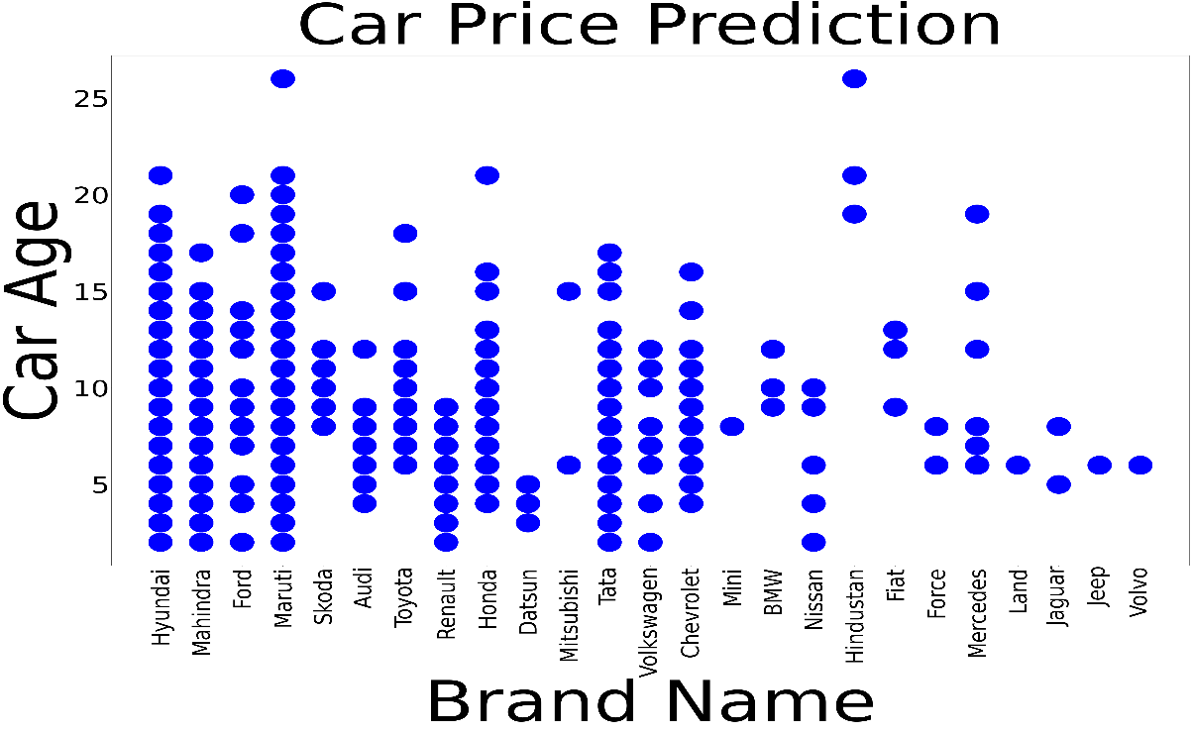
Prediction One
Parameters : Brand Name, Car Age
Algorithm : Multiple Leaner Regression
Accuracy : 1.0
Presented By: Pijush Kanti Laskar
Dataset
Generated Graph
Brand Name | Car Age
Audi | 10
Maruti | 8
Tata | 7
Mahindra | 6
Ford | 5
Hyundai | 14

Slide 4
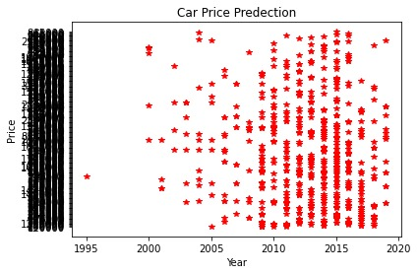
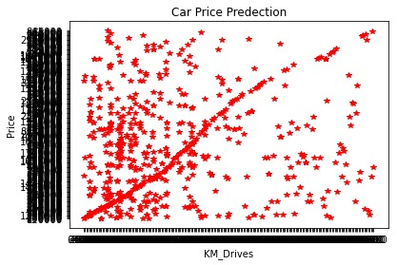
Prediction Two
Parameters : Year, KM Driven, Fuel Type
Algorithm : Multiple Leaner Regression
Accuracy : 1.0
Presented By: Santanu Saha
Dataset
Generated Graph
Year | KM Driven | Fuel Type
2010 | 10 | Petrol
2011 | 8 | Diesel
2000 | 7 | LPG
2012 | 6 | Petrol
2008 | 5 | Diesel
2009 | 14 | LPG

Slide 5
Analysis One
Parameters : Year, Brand Name
Algorithm : General Column Chart
Presented By: Satyajit Mallick
Dataset
Generated Graph
Year | Brand Name | Total Sale
2010 | Audi | 8
2010 | Maruti | 6
2010 | Tata | 9
2010 | Mahindra | 16
2010 | Ford | 17
2010 | Hyundai | 2

Slide 6
Analysis Two
Parameters : Year, Fuel Type
Algorithm : General Column Chart
Presented By: Soujatya Bhattacharya
Dataset
Generated Graph
Year | Fuel Type | Total Sale
2010 | LPG | 8
2010 | Petrol | 6
2010 | Diesel | 9

Slide 7
Project Contributors
Pijush Kanti Lasker (Predict car price based on Brand Name, Car Age)
Santanu Saha (Predict car price based Year, KM Driven, Fuel Type)
Satyajit Mallick (Analyse Saled Car VS Car Model based on specific year)
Soujatya Bhattacharya (Analyse Saled Car VS Fuel Type based on specific year & Web Application Interface Design)
Project Guide
Mr Tanmay Dey (Assistance Professor at MCA/BCA Department of Netaji Subhash Engineering College)

Slide 8
Thank You

